Slide 1
Face Recognition
Attendance System
- IT Department,AITR
Submitted To: Submitted By:
Naman Jain
NitinBaghel Narendra Palsingh
Pranjal Soni
Roshan Mahjajan
Sachin.G.Patidar
Notes:
1

Slide 2
Content
Introduction
Facial Recognition
Implementation
How it works
Strengths & Weaknesses
Applications
Advantages
Disadvantages
Conclusion

Slide 3
Introduction
Everyday actions are increasingly being handled electronically, instead of pencil and paper or face to face.
This growth in electronic transactions results in great demand for fast and accurate user identification and authentication.

Slide 4
Access codes for buildings, banks accounts and computer systems often use PIN's for identification and security clearences.
Using the proper PIN gains access, but the user of the PIN is not verified. When credit and ATM cards are lost or stolen, an unauthorized user can often come up with the correct personal codes.
Face recognition technology may solve this problem since a face is undeniably connected to its owner expect in the case of identical twins.

Slide 5
Facial Recognition ???
It requires no physical interaction on behalf of the user.
It is accurate and allows for high enrolment and verification rates.
It can use your existing hardware infrastructure, existing camaras and image capture Devices will work with no problems

Slide 6
Facial Recognition
In Facial recognition there are two types of comparisons:-
VERIFICATION- The system compares the given individual with who they say they are and gives a yes or no decision.
IDENTIFICATION- The system compares the given individual to all the Other individuals in the database and gives a ranked list of matches.

Slide 7
Contd…
All identification or authentication technologies operate using the following four stages:
Capture: A physical or behavioural sample is captured by the system during Enrollment and also in identification or verification process.
Extraction: unique data is extracted from the sample and a template is created.
Comparison: the template is then compared with a new sample.
Match/non-match: the system decides if the features extracted from the new Samples are a match or a non match.

Slide 8
Implementation
The implementation of face recognition technology includes the following four stages:
Image acquisition
Image processing
Distinctive characteristic location
Template creation
Template matching

Slide 9
Image acquisition
Facial-scan technology can acquire faces from almost any static camera or video system that generates images of sufficient quality and resolution.
High-quality enrollment is essential to eventual verification and identification enrollment images define the facial characteristics to be used in all future authentication events.

Slide 10
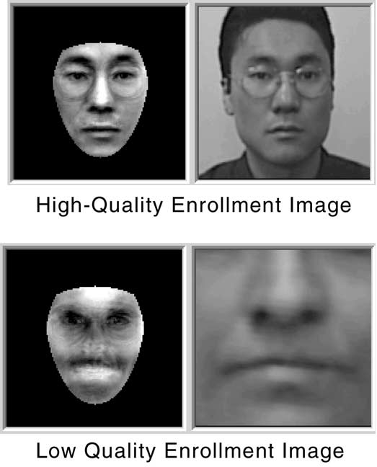

Slide 11
Image Processing
Images are cropped such that the ovoid facial image remains, and color images are normally converted to black and white in order to facilitate initial comparisons based on grayscale characteristics.
First the presence of faces or face in a scene must be detected. Once the face is detected, it must be localized and Normalization process may be required to bring the dimensions of the live facial sample in alignment with the one on the template.

Slide 12
Distinctive characteristic location
All facial-scan systems attempt to match visible facial features in a fashion similar to the way people recognize one another.
The features most often utilized in facial-scan systems are those least likely to change significantly over time: upper ridges of the eye sockets, areas around the cheekbones, sides of the mouth, nose shape, and the position of major features relative to each other.

Slide 13
Contd..
Behavioural changes such as alteration of hairstyle, changes in makeup, growing or shaving facial hair, adding or removing eyeglasses are behaviours that impact the ability of facial-scan systems to locate distinctive features, facial-scan systems are not yet developed to the point where they can overcome such variables.

Slide 14
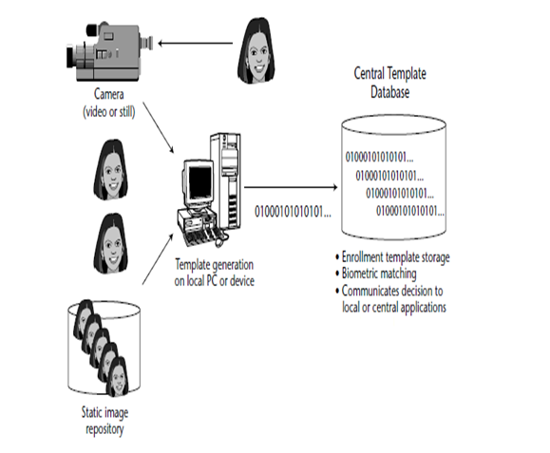
Template creation

Slide 15
Enrollment templates are normally created from a multiplicity of processed facial images.
These templates can vary in size from less than 100 bytes, generated through certain vendors and to over 3K for templates.
The 3K template is by far the largest among technologies considered physiological biometrics.
Larger templates are normally associated with behavioral biometrics,

Slide 16
Template matching
It compares match templates against enrollment templates.
A series of images is acquired and scored against the enrollment, so that a user attempting 1:1 verification within a facial-scan system may have 10 to 20 match attempts take place within 1 to 2 seconds.
facial-scan is not as effective as finger-scan or iris-scan in identifying a single individual from a large database, a number of potential matches are generally returned after large-scale facial-scan identification searches.

Slide 17
How Facial Recognition System Works
Facial recognition software is based on the ability to first recognize faces, which is a technological feat in itself. If you look at the mirror, you can see that your face has certain distinguishable landmarks. These are the peaks and valleys that make up the different facial features.
VISIONICS defines these landmarks as nodal points. There are about 80 nodal points on a human face.

Slide 18
Contd..
Here are few nodal points that are measured by
the software.
distance between the eyes
width of the nose
depth of the eye socket
cheekbones
jaw line
chin

Slide 19
SOFTWARE
Detection- when the system is attached to a video surveilance system, the recognition software searches the field of view of a video camera for faces. If there is a face in the view, it is detected within a fraction of a second. A multi-scale algorithm is used to search for faces in low resolution. The system switches to a high-resolution search only after a head-like shape is detected.
Alignment- Once a face is detected, the system determines the head's position, size and pose. A face needs to be turned at least 35 degrees toward the camera for the system to register it.

Slide 20
Normalization-The image of the head is scaled and rotated so that it can be registered and mapped into an appropriate size and pose. Normalization is performed regardless of the head's location and distance from the camera. Light does not impact the normalization process.
Representation-The system translates the facial data into a unique code. This coding process allows for easier comparison of the newly acquired facial data to stored facial data.
Matching- The newly acquired facial data is compared to the stored data and (ideally) linked to at least one stored facial representation.

Slide 21
The system maps the face and creates a faceprint, a unique numerical code for that face. Once the system has stored a faceprint, it can compare it to the thousands or millions of faceprints stored in a database.
Each faceprint is stored as an 84-byte file.

Slide 22
Strengths
It has the ability to leverage existing image acquisition equipment.
It can search against static images such as driver’s license photographs.
It is the only biometric able to operate without user cooperation.

Slide 23
Weaknesses
Changes in acquisition environment reduce matching accuracy.
Changes in physiological characteristics reduce matching accuracy.
It has the potential for privacy abuse due to noncooperative enrollment and identification capabilities.

Slide 24
Applications
Replacement of PIN, physical tokens
No need of human assistance for identification
Prison visitor systems
Border control
Voting system
Computer security
Banking using ATM
Physical access control of buildings ,areas etc.

Slide 25
Disadvantage
Problem with false rejection when people change their hair style, grow or shave a beard or wear glasses.
Identical twins

Slide 26
Advantages
Convenient, social acceptability
Easy to use
Inexpensive technique of identification

Slide 27
Conclusion
Factors such as environmental changes and mild changes in appearance impact the technology to a greater degree than many expect.
For implementations where the biometric system must verify and identify users reliably over time, facial scan can be a very difficult, but not impossible, technology to implement successfully.

Slide 28
Thank You…

Slide 29
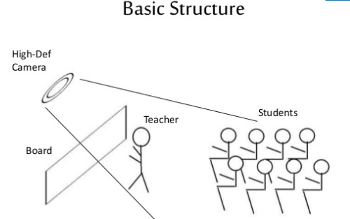

Slide 30
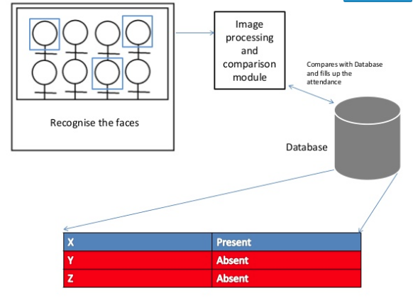

Slide 31
